Slide 1
Threat Modeling

Slide 2

WHO?!
When you're connected to the Internet you are in fact connected to a network with MANY other users. Unfortunately, when something as big as this is shared, it's wide open to abuse.
Crackers / Hackers
Malware / Viruses
Opportunists
You NEED secure software.
Anti-Virus / Spyware Detector / Anti-Trojan
Firewall / IDS
Good Software
Notes:
The internets is an ocean of machines that connect to each other, send useless data like pings and heartbeats. Sometimes we send interesting information like our address, telephone numbers, the amount of salary we get etc. And the more time passes the more valuable type of info we pass through the net like our bank details, payments, Social Security Numbers/NINs, Insurance Numbers, passwords etc.
In this ocean we can meet the various predators that are ready to snatch that information and use it for their own good -> we have:
Crackers -> this is what we are used to know by the term hacker. These are the bad guys -> they target you for what you know/have. They want to exploit everything they can get their hands on and make profit.
Hackers -> this generally security researchers, security experts, pen-testers, red team members, even you as the terms originates from MIT and means a person that will use a piece of equipment (typically a computer) in unusual ways.
Opportunists / Script Kiddies – not always technical, not always computer proficient. Example – Vault 7 gets released (the big NSA leak) you read on a thing called Eternal Blue you know (because it written in the comments) how to run it against your friend to run any command as ADMIN -> you decide to have fun with it
Any random Malware/ Virus that gets released on the network will eventually hit your ISP and potentially you.
YOU

Slide 3
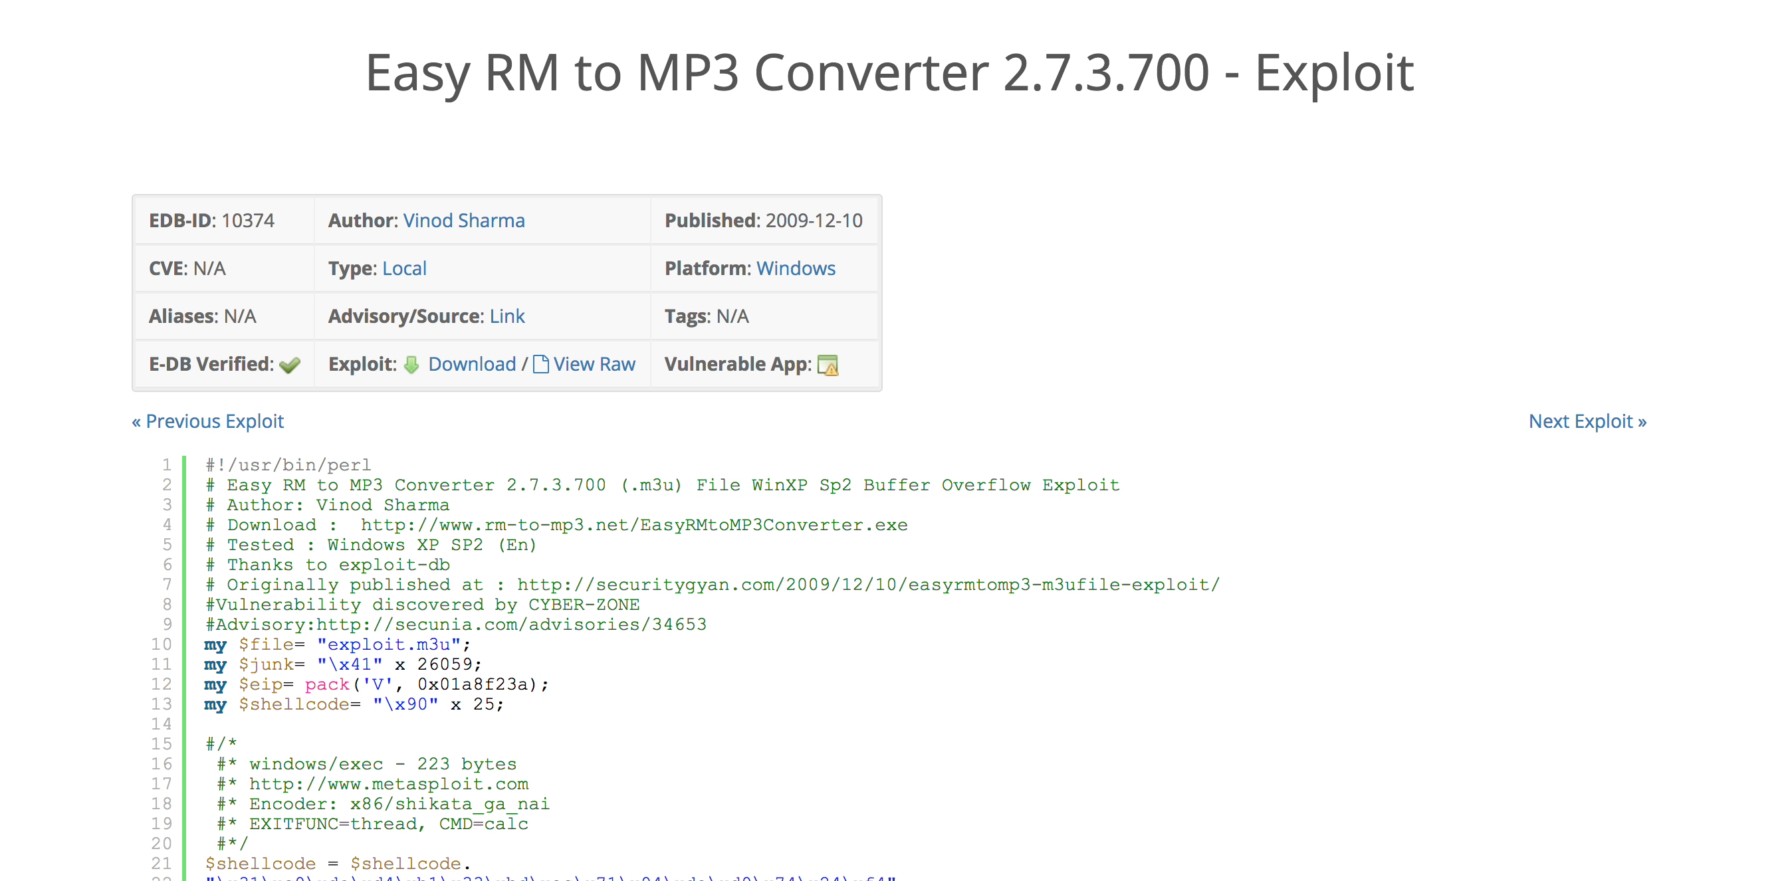
Subhead
Notes:
Finding an exploit is easy

Slide 4
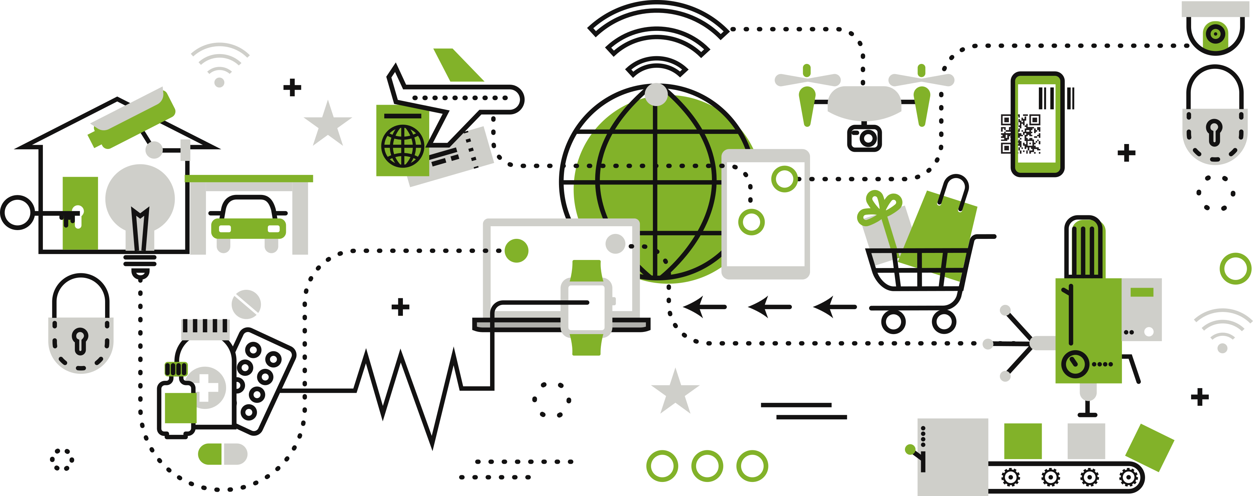
SYSTEM
Notes:
Finding an exploit is easy

Slide 5


HOW?!
Network Engineers - to do an unbreakable network
Premise security firms – to filter all employees
Awesome unbreakable Software Suits – to have no sketchy code
Awesome unbreakable Operating Systems - to manage EVERYTHING you do in a safe way
Perfect Loyal Employees – to be ready to do anything for their company
Perfect Cleaning crew – that will check every piece of garbage for possible leak of internal information
Regular updates – from ALL of the software vendors you use
EASY!
Notes:
You need that (points)
Do you find anything less than possible in a single days work ? :D
CATS AND DOGS
-> at a point in time you might have everything like that but as time progresses keeping everything in perfect unbreakable state is impossible
-> you need to plan ahead so that your systems can be as protected as possible for the longest possible time and when they get vulnerable due to anything – new issues uncovered, external companies misbehaving, mad employees, throwing a document in the bin rather than the shredder etc
BUT we all here are doing Software Engineering so lets make a few assumptions at first;
Network in general is going to be safe
Premise security is going to be perfect
OS on latest updates will be safe
Employees will be happy
Only crazy people do Dumpster Diving (actual red team approach to finding information)

Slide 6

Things to Consider
You do your Software Architecture
You do your Data Modeling
You do your User Experience flow
You do your User Interface Designs
You do your Secure Development Lifecycle
You will either have an SME for each task above or have to as a developer do everything
Good luck !
Notes:
Each piece of software can be broken down into some key components and I am not saying these are all of them:
You have a Data model that will describe what kind of data you are dealing with and where and why its stored
You have a UI which might be very important – look at apps that are successful and you will see that all of them have very polished UX - and there is a major difference between UI and UX
You already have so much to do to make your app just run you can imagine how security (considering is not essential for the general functionality of your application can be left out – alone- under the rain – scared)
Is security the future -> according to a lot of people YES. We are dealing with a more and more hostile en
And then security:
In general security is shown in the form of the OWASP top 10 which are very important and there is a reason they are the top 10 :D
But there are things that owasp top 10 cannot protect you from
Design a threat model

Slide 7

Steps
Assessment Scope – what do we care about
System Modeling – decompose the software
Identity Threats – who will target you and why
Identify Vulnerabilities - how will they target you
Examining the Threat History
Evaluation or impact on the Business
Developing a Security Threat responsible Plan !

Slide 8
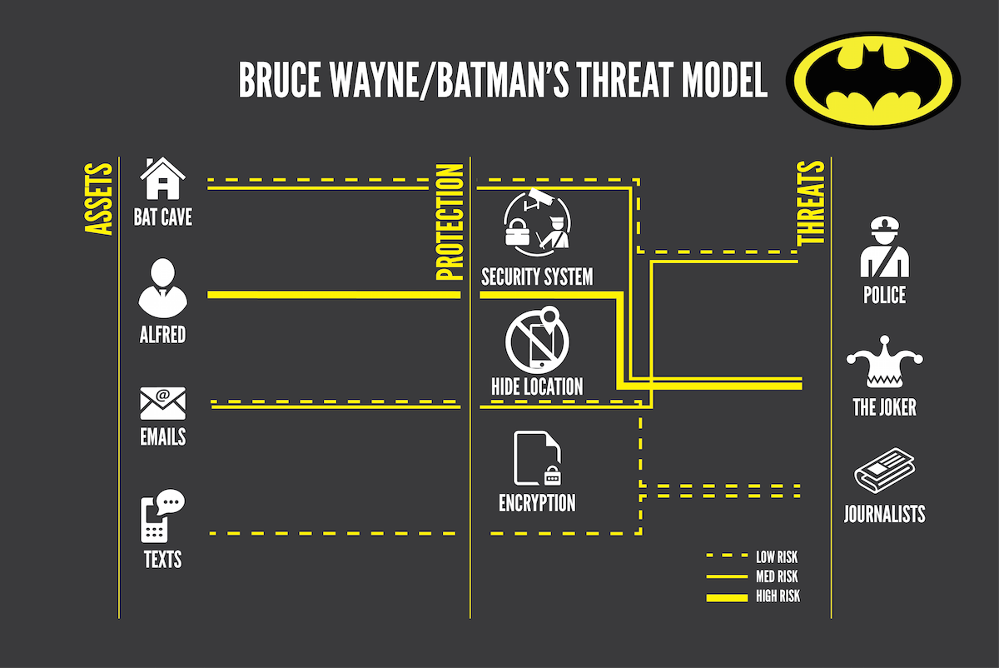
Steps
Notes:
Here's how batman did it and we all know batman can defeat superman 1v1 because he is always prepared.
But Batman also lifes by threat modeling and even you do it daily. A simple thing like not eating garlic before a date with catwoman or not turning on the boost of his batcar right before intersection are thing batman and you do every day.
It can be used for both security and accidental failures.
Threat modeling is a planned activity for identifying and assessing application threats and vulnerabilities
OTHER THINGS BATMAN MIGHT NEED TO THINK ABOUT in terms of Security and Failure

Slide 9
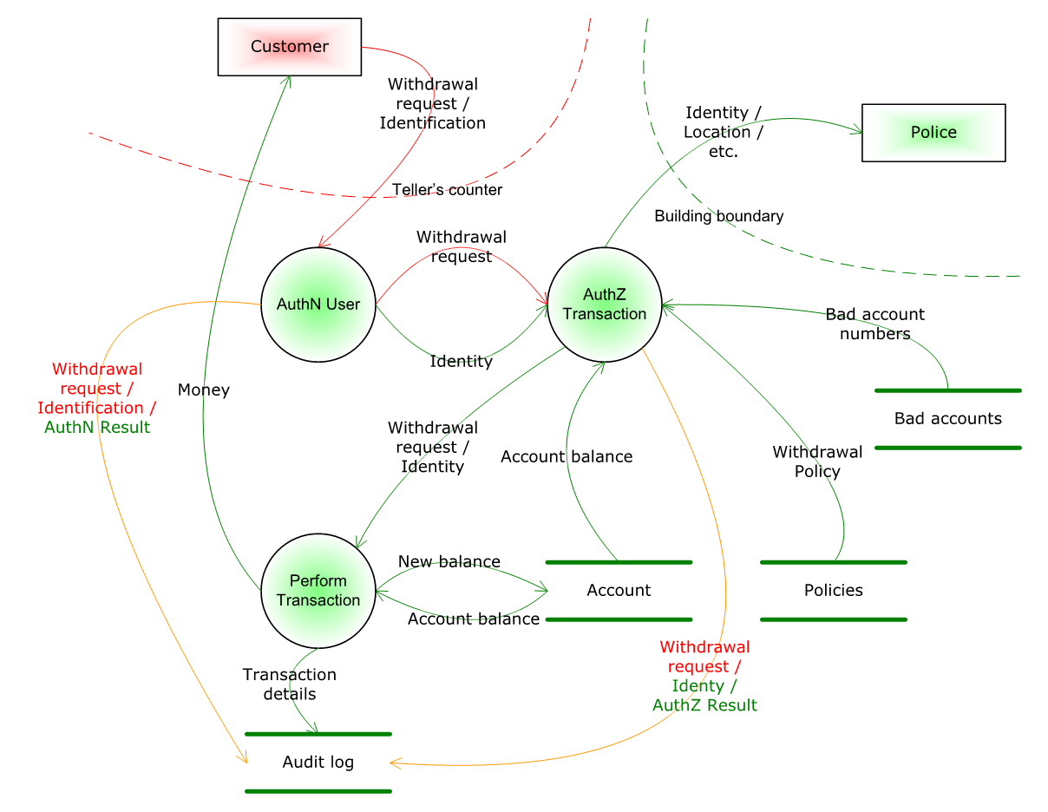
Steps
Notes:
Here's how batman did it and we all know batman can defeat superman 1v1 because he is always prepared.
But Batman also lifes by threat modeling and even you do it daily. A simple thing like not eating garlic before a date with catwoman or not turning on the boost of his batcar right before intersection are thing batman and you do every day.
It can be used for both security and accidental failures.
Threat modeling is a planned activity for identifying and assessing application threats and vulnerabilities
OTHER THINGS BATMAN MIGHT NEED TO THINK ABOUT in terms of Security and Failure

Slide 10


STRIDE vs PASTA
Spoofing Tampering Repudiation Information Disclosure Denial of Elevation of Privilege
Process for Attack Simulation And Threat Analysis

Slide 11
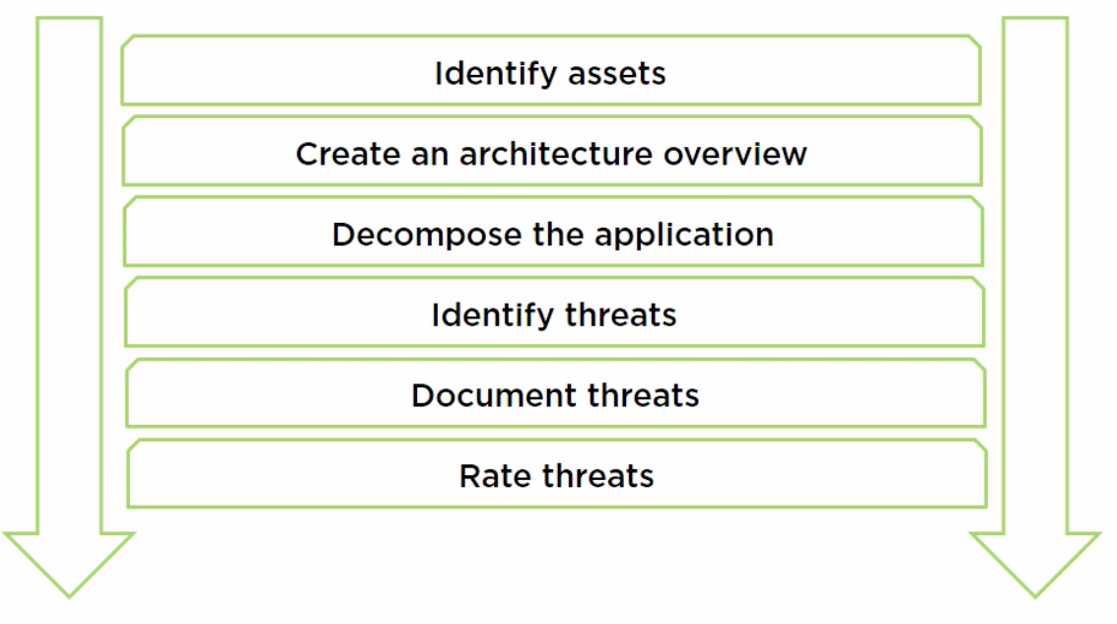
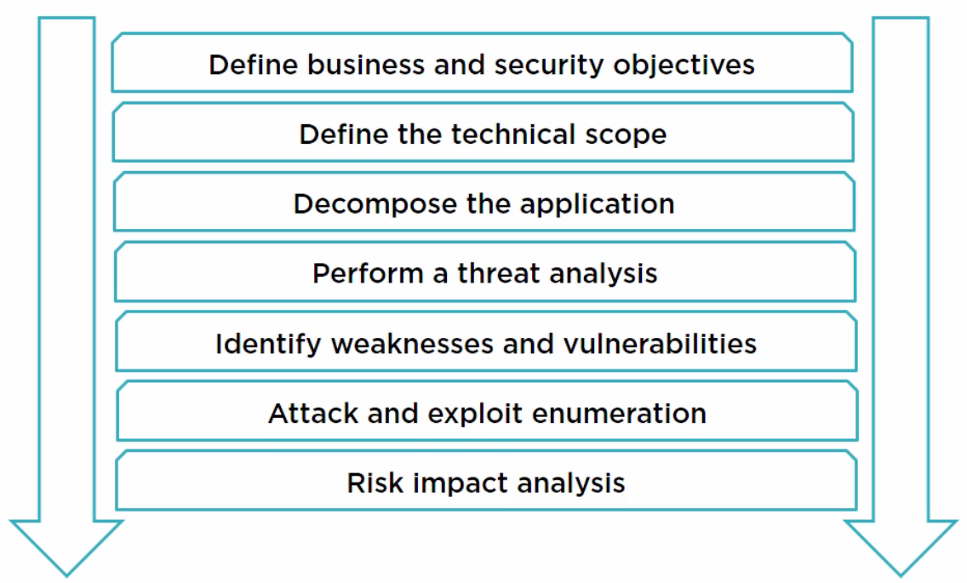
STREIDE PASTA
Notes:
Data flow diagram
Example
| (auth)
| 🔄
[web browser] 🔄 (web server)🔄| pictures |
| 🔄
| (verify)

Slide 12

Damage Reproducibility Exploitability Affected Users Discoverability
DREAD
None = 0 Low = 1 Medium =2 High =3
(D+R+E+A+D)/5 = RISK
Is RISK > 1:
Fix NAO
Is RISK <1:
FIX TOMORROW
(DreaD-D)

Slide 13
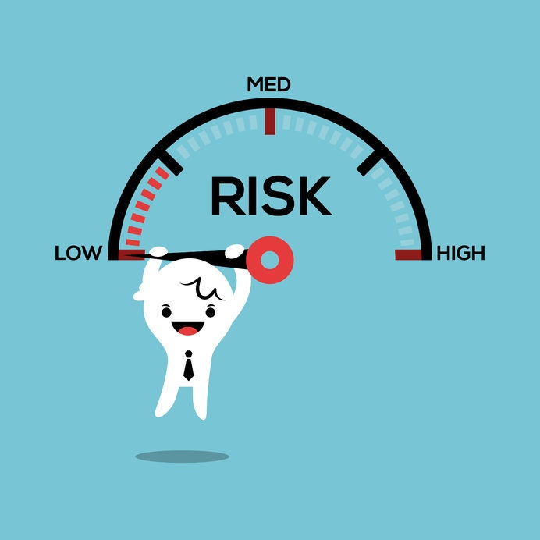
Other things we do to mitigate Risk
Automation/Process
Static Scanning
Dynamic Scanning
Componentization
Pen Testing / External Pen Testing
Red Team Testing
In team testing
Notes:
Static Scanning is performed by a tool that is typically done by an external vendor. This tool will go and scan the code base of an application and try to identify bad code that leads to vulnerabilities.
Dynamic Scanning will try to go through a compiled/deployed version of the application and find entry points to inject flawed or malicious data and identify issues with the application such as leaking tooling information or even PI.
Componentization of security modules allows us to vigorously test and reuse our security components. This also means we can test/scan each component and always be sure its up to the best standards. Also means that all the applications using it have the same level of security layers.
Whenever the attack surface changes and/or the attack surface increased we need to do a pen tests. If we have a choice we do an internal pen test but we do not hire that many pen testers so sometimes we hire an external vendor
Red Team Testing – this is the bane of every security expert/developer/manager anyone who is not the red team member. This person typically either hired in a different city and or might be working in a team will come and for months attack the building and everyone in it. This person typically will approach the problem without any prior knowledge and/or access. So his target might be computers in left wing of Alhambra house in Glasgow.
-> tell them about the BT example

Slide 14

Treats
OWASP top 10 web threats
OWASP top 10 mobile threats
Misconfigurations
Buffer Overflows
Weak passwords
Over privileged users
Lack of updates
Lack of backups
Assumptions
Angry employees
Spying
Notes:
Static Scanning is performed by a tool that is typically done by an external vendor. This tool will go and scan the code base of an application and try to identify bad code that leads to vulnerabilities.
Dynamic Scanning will try to go through a compiled/deployed version of the application and find entry points to inject flawed or malicious data and identify issues with the application such as leaking tooling information or even PI.
Componentization of security modules allows us to vigorously test and reuse our security components. This also means we can test/scan each component and always be sure its up to the best standards. Also means that all the applications using it have the same level of security layers.
Whenever the attack surface changes and/or the attack surface increased we need to do a pen tests. If we have a choice we do an internal pen test but we do not hire that many pen testers so sometimes we hire an external vendor
Red Team Testing – this is the bane of every security expert/developer/manager anyone who is not the red team member. This person typically either hired in a different city and or might be working in a team will come and for months attack the building and everyone in it. This person typically will approach the problem without any prior knowledge and/or access. So his target might be computers in left wing of Alhambra house in Glasgow.
-> tell them about the BT example

Slide 15
Leaks
Private Information
Public Information
Incriminating Information
Critical Information
WHAT IS CRITICAL FOR YOUR APP ?
WHAT IS CRITICAL FOR YOUR EMPLOYEE ?
Notes:
Static Scanning is performed by a tool that is typically done by an external vendor. This tool will go and scan the code base of an application and try to identify bad code that leads to vulnerabilities.
Dynamic Scanning will try to go through a compiled/deployed version of the application and find entry points to inject flawed or malicious data and identify issues with the application such as leaking tooling information or even PI.
Componentization of security modules allows us to vigorously test and reuse our security components. This also means we can test/scan each component and always be sure its up to the best standards. Also means that all the applications using it have the same level of security layers.
Whenever the attack surface changes and/or the attack surface increased we need to do a pen tests. If we have a choice we do an internal pen test but we do not hire that many pen testers so sometimes we hire an external vendor
Red Team Testing – this is the bane of every security expert/developer/manager anyone who is not the red team member. This person typically either hired in a different city and or might be working in a team will come and for months attack the building and everyone in it. This person typically will approach the problem without any prior knowledge and/or access. So his target might be computers in left wing of Alhambra house in Glasgow.
-> tell them about the BT example

Slide 16

Challenges
Threat modeling is for everyone – security expert is not the only person in the room doing it
Ethical Hacking helps test possible threats
Testing helps test possible threats
Threat Modeling is not a scientific value for risk
Historical data is vital – without any data, estimations will be wrong
Overthinking every aspect of the project for threats can halt progress – know when to stop
Switch approaches every few sprints to check the product from different angles

Slide 17


Challenges
No need for expensive tools
Good documentation helps a lot
Available solutions to existing problems need to be recorded so that replication of work doesn't happen
Not a means to fix all issues but definitely a way to reduce exposure
Notes:
Its easy but its part of the process
You need to realize that threat modeling and thinking about threats is as important as doing your daily standup

Slide 18


Recap
Threat Modeling
STRIDE
PASTA
DREAD
Security is not a one-off thing – its continuous
Security is not easy – you are either one step behind or on the same level as the attackers
If you are a security expert and you never get called in your bosses office – you have done a great job.
Know your threats
Notes:
Static Scanning is performed by a tool that is typically done by an external vendor. This tool will go and scan the code base of an application and try to identify bad code that leads to vulnerabilities.
Dynamic Scanning will try to go through a compiled/deployed version of the application and find entry points to inject flawed or malicious data and identify issues with the application such as leaking tooling information or even PI.
Componentization of security modules allows us to vigorously test and reuse our security components. This also means we can test/scan each component and always be sure its up to the best standards. Also means that all the applications using it have the same level of security layers.
Whenever the attack surface changes and/or the attack surface increased we need to do a pen tests. If we have a choice we do an internal pen test but we do not hire that many pen testers so sometimes we hire an external vendor
Red Team Testing – this is the bane of every security expert/developer/manager anyone who is not the red team member. This person typically either hired in a different city and or might be working in a team will come and for months attack the building and everyone in it. This person typically will approach the problem without any prior knowledge and/or access. So his target might be computers in left wing of Alhambra house in Glasgow.
-> tell them about the BT example

